Slide 1
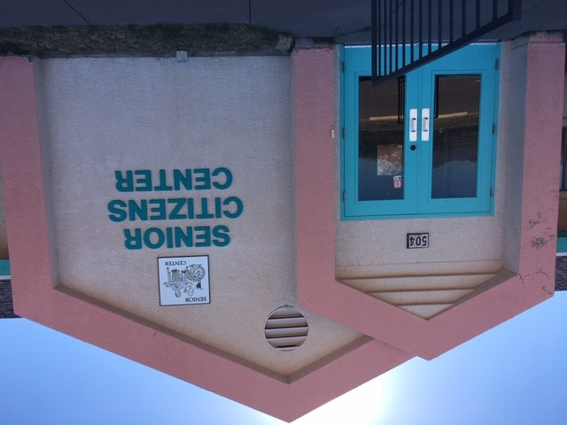
Huachuca City Senior Center
Action Plan

Slide 2
FACILITY IMPROVEMENTS NEEDED
Roof replaced-Completed 4/19
Gas Stove
Commercial Refrigerator
Floor tile
Shelving
To be replaced on FY 18-19
Note: Staff is currently searching GSA surplus for used commercial kitchen appliances.
Old appliances were removed by Senior Center, LLC.

Slide 3
CONGREGATE MEALS
Currently there is no funding for Congregate Meals.
Even with SEAGO Funding, our portion of the operational costs would be at least 7K more than what is currently in the FY19-20 budget—could be more. We would also incur additional costs for equipment, materials, and personnel.
When the Town’s economic condition improves (FY 20-21), we will be in a better position to meet the required match and will attempt to obtain SEAGO funding for meals. Will give us time to connect with other organizations to maximize our efforts.
In the meantime, the Senior Center can be utilized in other ways to serve our seniors and other members of our community

Slide 4
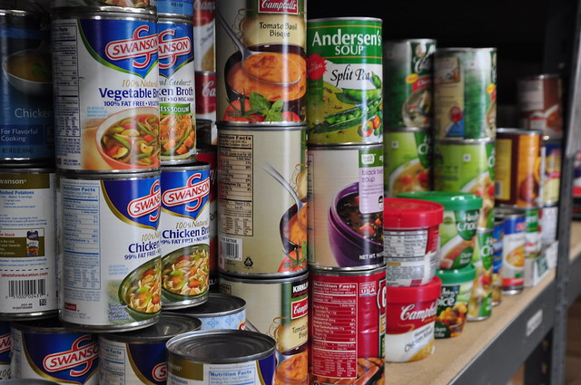
FOOD BANK
Partnerships: Tombstone Food Bank, Healthy Huachuca Committee, Community Garden; other possible partners include local churches and Produce on Wheels
Open 2 days per week – potential to serve many in the community – as many as 300 month (Note: 300 is 20% of the number of people Tombstone Food Bank is currently serving monthly.)
Volunteer staffed

Slide 5
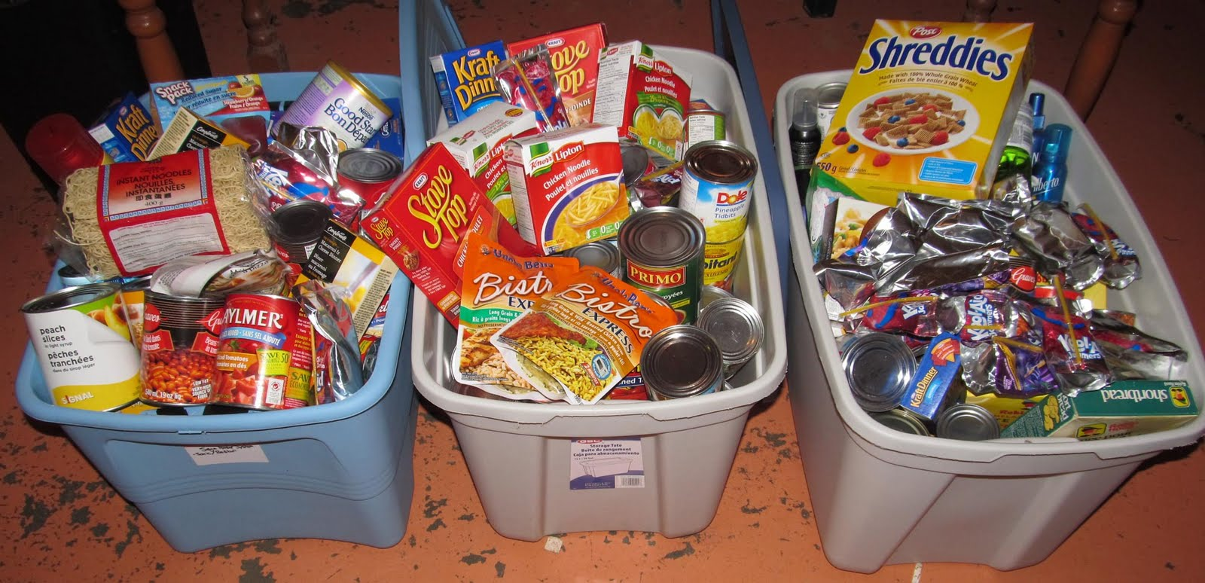
BENEFIT TO THE COMMUNITY
-Access to food for a greater number of people than congregate meal program
-Will serve families as well as seniors
-Will complement an eventual meal program
-Low start up costs – Shelving/storage
-Benefit to community is immediate
-Plan to relocate Sears conex from Fire Dept
to Senior Center for additional storage

Slide 6
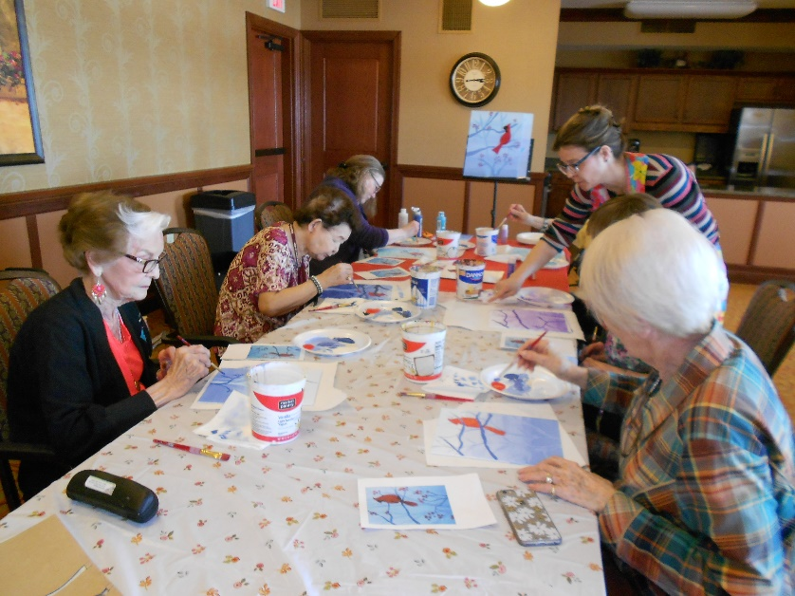
COMMUNITY AND LIBRARY PROGRAMMING
Senior Center can become an educational and social hub
SEAGO Area Agency on Aging classes/workshops and program information
Library Programming for Seniors to include:
Computer Classes
Access to computers
Speakers on various subjects
Workshops on Medical/Legal/Social Programs
Nutrition for Seniors – University of Arizona, Cooperative Extension (4-week program to begin in July)
Fitness for Older Americans: Chair Yoga, Fit for Life, “A Matter of Balance”
Social activities to include a weekly social hour and monthly potluck. If there is interest, other events such as game night, Bunco, etc.

Slide 7
BENEFIT TO THE COMMUNITY
Flexibility! The Community and Library programs CAN be tailored to Seniors but they can also be expanded to include all community members which…
Provides opportunities for multi-generational interaction
Can increase community engagement and cohesiveness
Gives more bang for the tax-payer’s buck--stretches town dollars to provide benefit to a greater number of people
Will still provide focused services/education to Seniors

Slide 8
OTHER BENEFITS
Senior Center can be used for a myriad of community events
If we get locking cabinets for food bank items, could be rented out and thus generate revenue
Potential space for free or low-cost programs such as exercise classes, scrapbooking, canning classes, cooking classes, sewing classes, exercise classes, bingo, etc.
A Food Bank and Community/Library programming requires little up front funding.
The library is already planning and executing programming and can extend/expand programming to the Senior Center at little to no additional cost.
Several community members have already expressed an interest in volunteering at a potential Food Bank. The Healthy Huachuca Committee is also willing to help operate it.

Slide 9
Public spaces should be useful spaces that bring people together and be meaningful to the communities they serve. A shuttered building serves no one.

